Slide 1

Microservices Load Balancing with Ribbon
- Guru

Slide 2
Load Balancing
Wikipedia Definition:
In computing, load balancing refers to the process of distributing a set of tasks over a set of resources, with the aim of making their overall processing more efficient

Slide 3
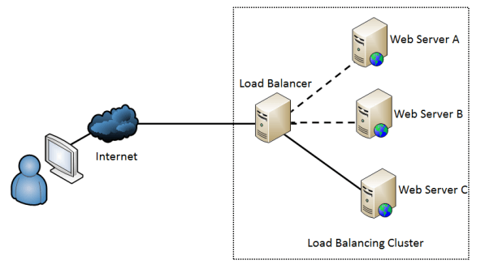
Load Balancing

Slide 4
Load Balancing
A load balancer acts the “traffic cop” sitting in front of your servers and routing client requests across all servers capable of fulfilling those requests in a manner -
that maximizes speed and capacity utilization and
Ensures that no one server is overworked
If a single server goes down, the load balancer redirects traffic to the remaining servers.
When a new server is added to the server group, the load balancer automatically starts to send requests to it.

Slide 5
Load Balancing Algorithms
Round Robin
Least Connections
Least Time
Hash (Based on a key you define)
IP Hash
Random with Two Choices

Slide 6
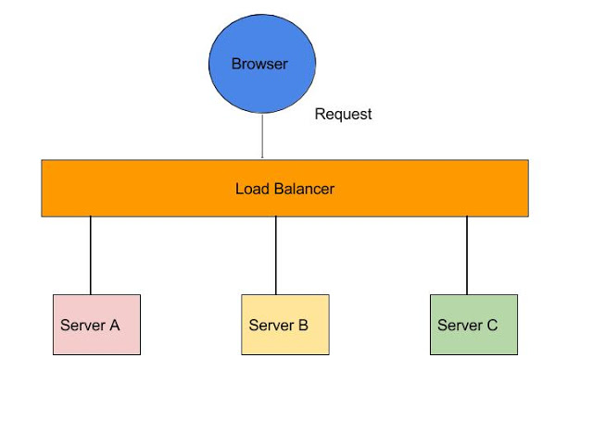
Server Side Load Balancer such as Netscaler

Slide 7
Server side Load Balancer
In Java EE architecture, we deploy our war/ear files into multiple application servers,
then we create a pool of server and put a load balancer (Netscaler) in front of it, which has a public IP.
The client makes a request using that public IP, and Netscaler decides in which internal application server it forwards the request by round robin or sticky session algorithm.
We call it server side load balancing.

Slide 8
Server side Load Balancer - Problems
If one or more servers stop responding, we have to manually remove those servers from the load balancer by updating the IP table of the load balancer.
Another problem is that we have to implement a failover policy to provide the client with a seamless experience.
So, microservices DON’T USE SERVER SIDE LOAD BALANCING

Slide 9
Client Side Load Balancer
Client-side load balancer like Ribbon, API caller (client) should know the list of servers and choose one of them from the list.
That's why we call it client-side load balancer.
But, When we are using traditional load balancer (server-side load balancer), API caller (client) only knows a single endpoint that is a load balancer and the client doesn't know the list of servers. Load balancer chooses a server from the list.

Slide 10
Client Side Load Balancer
Eureka uses client side Load balancer called
"RIBBON"

Slide 11
Use Case: Client Side Load Balancer
Let's create two simple microservices
HelloWorld
Runs on Port # 1111
Name: helloworld
HelloWorld1
Runs on Port # 2222
Name: helloworld
Register them in Eureka server

Slide 12
Use Case: Client Side Load Balancer
Let's create one more microservice (for consuming these microservices)
Call it: NetflixRibbonClient
Let it run on port no# 4444
Add the dependency:
<dependency>
<groupId>com.netflix.ribbon</groupId>
<artifactId>ribbon</artifactId>
</dependency>

Slide 13
Use Case: Client Side Load Balancer
Give the URL to access the HelloWorld microservices:
Netflixribbonclient url -> You can see it routes to first instance
Try again, you can see it routes to second instance
In round robin fashion

Slide 14
End of Load Balancing

